Slide 1


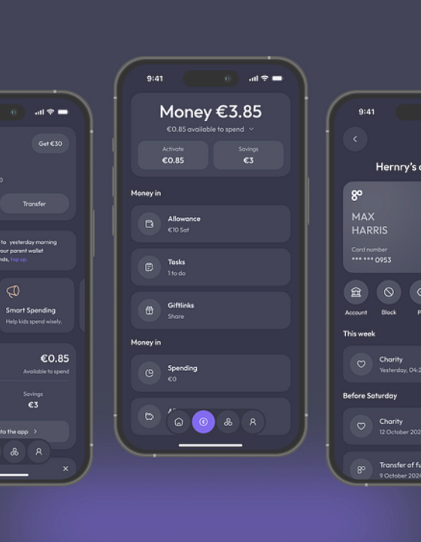
Automated Banking System
A Java Implementation
Group Name:
Aashutosh Subedi
Bishal Shah
Subash Kunwar
Aasish Rawal

Slide 2
DEFINITION
What is an Online Banking System?
A centralized digital platform replacing physical branches with 24/7 self-service transaction processing.

Slide 3


The Paradigm Shift
Traditional Banking
Digital Banking
Physical branches
Remote access
Paper ledgers
Memory arrays
Manual processing
Instant automation
Restricted hours
24/7 availability

Slide 4
PROBLEM 01
9 to 5
Restricted Access
Customers bound to physical locations during limited working hours.

Slide 5



PROBLEM 02
Manual Record-Keeping
Slow Retrieval
Human Error
Physical ledgers delay basic account inquiries.
Calculation mistakes during deposits or withdrawals.

Slide 6

PROBLEM 03
Inefficient Queues
Wasted Time
Waiting in long physical lines for simple tasks.
Resource Drain
Teller time consumed by routine transactions.

Slide 7

PROBLEM 04
Overdraft Risks
Manual teller processes risk approving withdrawals that exceed actual balances if ledgers lag.

Slide 8

The Digital Solution
Automated. Instant. Secure

Slide 9



SOLUTION 01:
24/7 ACCESS
Always On
Anywhere
Self-Serve
Independent financial management at any hour.
Accessible from any location with internet.
No reliance on branch staff or physical tellers.

Slide 10
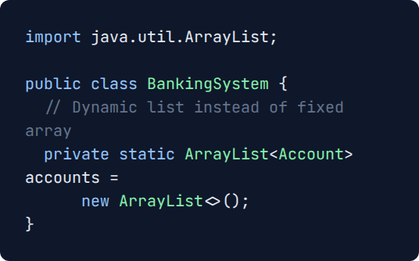

SOLUTION 02:
Centralized Database
Replaces physical paper ledgers with instant, memory-based Java Collections.

Slide 11






SOLUTION 03:
INSTANT PROCESSING
Input
Process
Confirm
User requests transaction.
Millisecond logic execution.
Instant balance update.

Slide 12

SOLUTION 04
Automated Validation
Programmed logic strictly enforces mathematical rules, actively preventing negative deposits and unauthorized overdrafts.

Slide 13


System Architecture
Account.java
BankingSystem.java
Scanner (I/O)
The Data Model. Stores customer state and handles pure math operations (deposit, withdraw).
Main Controller. Manages the ArrayList database and routes user choices to the correct logic.
User Interface. Captures console input, validates types, and handles standard output.

Slide 14


CORE COMPONENT
Encapsulated State
Private fields protect sensitive financial data from external modification. State is accessed strictly via getters.

Slide 15




Instant Account Generation
Input ID
FindAccount()
Input Name/Bal
Accounts.add()
Validates uniqueness before instantiating the object.

Slide 16
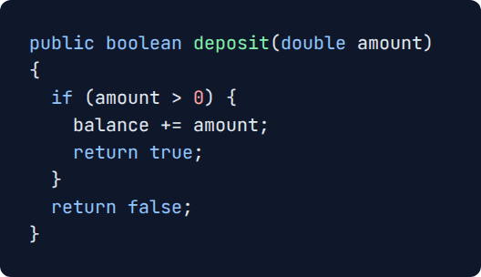

Secure Deposits
Positive amount validation explicitly rejects negative values, preventing exploit attempts.

Slide 17
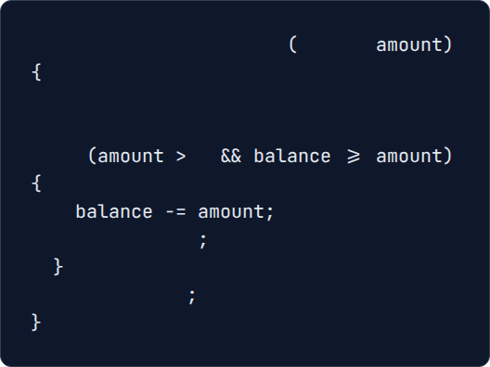
public boolean
withdraw
double
// Validates positive value AND funds
Overdraft Protection
if
0
Strict conditional logic actively blocks withdrawals that exceed current balance.
return true
return false

Slide 18
Real-Time Data Retrieval
ID
Name
$
Primary Key Lookup
Object Property
Live Balance

Slide 19





Future Enhancements
Persistent Storage
Graphical UI
History Log
Multi-Currency
MySQL or File I/O.
JavaFX or Swing.
Track specific transfers.
Exchange rate logic.

Slide 20
Thank You

